Slide 1
Four Classic Government Interventions in Perfectly Competitive Market
Dr. Jennifer P. Wissink
©2011 John M. Abowd and Jennifer P. Wissink, all rights reserved.

Slide 2
4 Classic Government Interventions
Price floors
Price ceilings
Quantity Quotas
Commodity Taxes

Slide 3
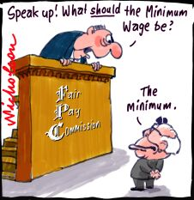
Price Floors
Government established minimum selling price.
Floor must be above P* to be binding.
Why? Government usually thinks the market price is too low for some reason.
Usually end up with….
Surpluses!
And all the problems they create.
Examples:
supported milk prices & minimum wage laws

Slide 4
Price Floors & Market Surplus
Equilibrium is at P*=17 and Q*=23.
Price
Demand
P_{floor} = $25.
Supply
At the artificially high price of $25, sellers want to sell 31.
Surplus = 16
25
But buyers only want to buy 15.
17
There is a surplus of 16.
And then what?
15
23
31
Quantity

Slide 5
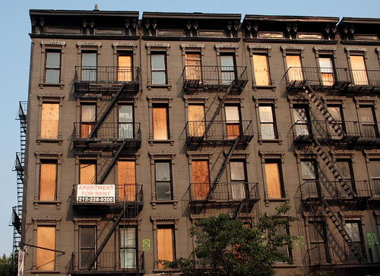
Price Ceilings
Government established maximum selling price.
Must be below P* to be binding.
Why? Government usually thinks the market price is too high for some reason.
Usually end up with….
Shortages!
And all the problems they generate.
Examples:
Gas price ceilings & apartment rent control

Slide 6
Price Ceiling & Market Shortage
Equilibrium is at P*=17 and Q*=23.
Price
Demand
P^{ceiling}=$10.
Supply
At the artificially low price of $10, buyers want to buy 30.
P^{B}
17
But sellers only want to sell 16.
10
Shortage = 14
There is a shortage of 14.
16
23
30
Quantity
And then what?

Slide 7
Quantity Quota
Government established maximum number of units sold.
Q^{max} must be below Q* to be binding.
Why? Government thinks too many units are being traded.
Example: import restrictions
Usually end up with...
Higher prices and more.

Slide 8
Quantity Quotas
P
P
D
D
S
S

Slide 9
Commodity Taxes
Government sets a tax on transactions.
Per unit
Ad valorem
Government decides who it will collect the tax revenue from (the statutory incidence).
The market decides who will really pay the tax (the economic price incidence).

Slide 10
Economic Price Incidence of a Per Unit Commodity Tax (EPI)
Before the tax:
Market price
Demand price
Supply price
After the tax:
Market price
Demand price
Supply price
Economic Price Incidence:
EPI on demanders
EPI on suppliers

Slide 11
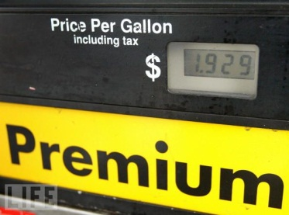
EPI of a Per Unit Commodity Tax
Consider the market for gasoline (G).
Impose a 10¢ per gallon tax.
Legally collect tax revenues from gas suppliers.
Vertically lifts the market supply up by 10¢ at every quantity.
Note, the after-tax, true supply curve is unchanged. This reflects what the suppliers will net as a per unit price after all tax obligations have been met.
The new equilibrium will be where market demand equals market supply.
The new market price, P*, reflects the price demanders pay, P^{D}.
The price suppliers receive, P^{S} is this price minus the per unit tax.
The EPI to demanders is 4¢.
The EPI to suppliers is 6¢.
P
D
S
Q

Slide 12
EPI of a Per Unit Commodity Tax
Would it have made a difference if we taxed the demanders instead of suppliers?
NO!
P
S
D
Do demanders and suppliers always share the EPI of a commodity tax 60/40?
NO!
Q

Slide 13
EPI of a Per Unit Commodity Tax
Price
Suppose the demand curve is vertical.
Suppose the tax is being legally collected from suppliers.
Even though the tax was legally collected from supplies, the suppliers are able to pass the entire tax on to the demanders. This is because the demanders are WILLING to pay it, based on the vertical demand assumed here.
D
S
Quantity

Slide 14
EPI of a Per Unit Commodity Tax Try These Three Cases On Your Own
P
D
S
P
S
D
Q
P
S
Q
D
Q

Slide 15
Final Comments

