Slide 1
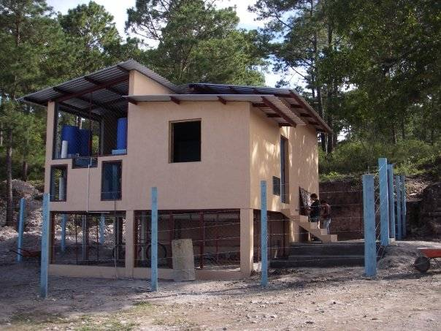
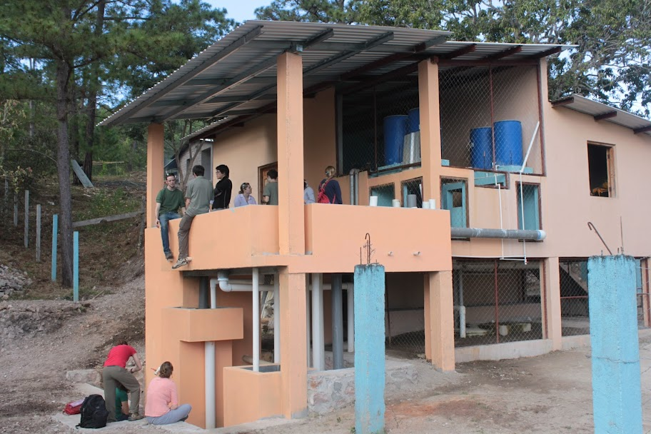
Water Treatment

Slide 2
Reflections
What are the two broad tasks of environmental engineers?
What is the connection between the broad tasks of environmental engineers and building a water treatment plant?
Why may the water need to be changed/treated?
What is the biggest water quality issue for the 1 billion who don’t have access to safe water?

Slide 3
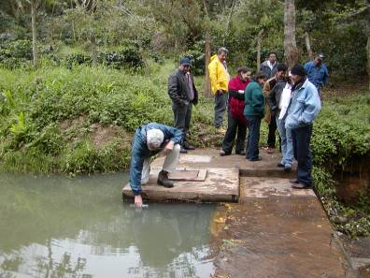
Simple Sorting
Goal: clean water
Source: (contaminated) surface water
Solution: separate contaminants from water
How?
  Take advantage of
  differences between
  water and contaminants

Slide 4
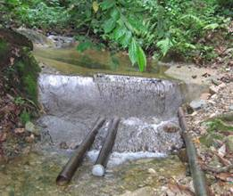
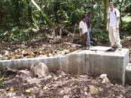
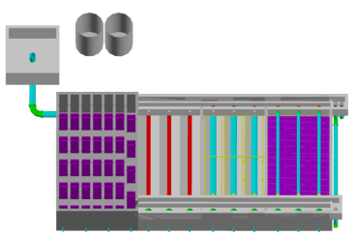
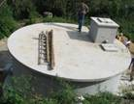
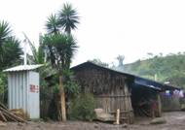
Gravity Water Supply
Distribution Tank
Spring box or dam

Slide 5
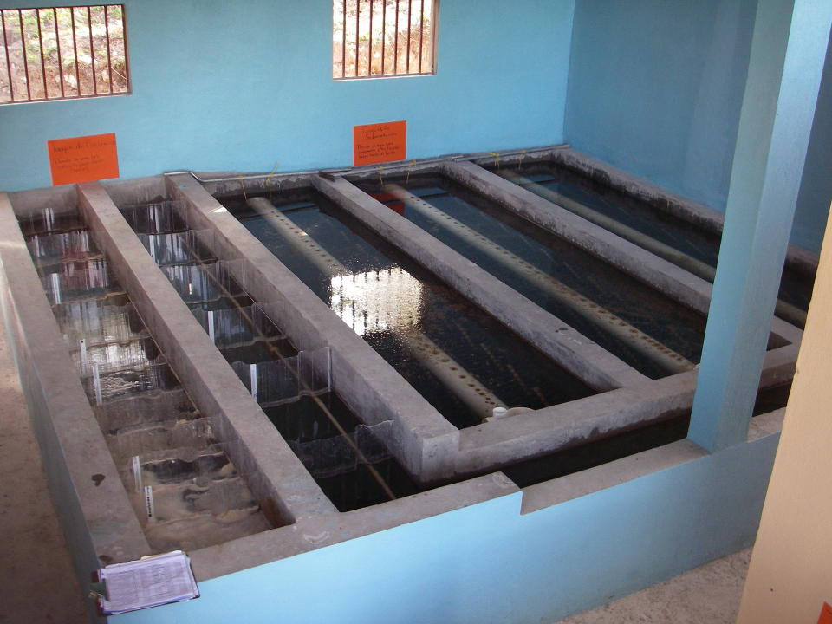
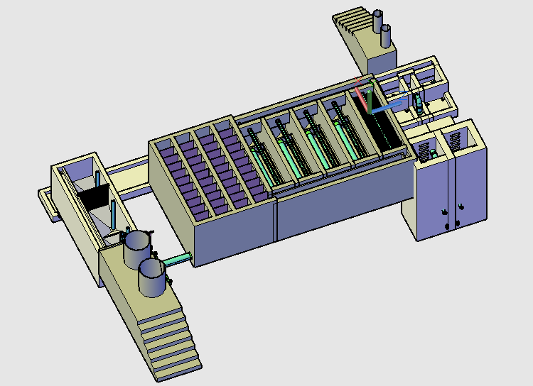
Stacked Rapid Sand Filters
Flocculator
Sedimentation
Tanks
Entrance Tank

Slide 6
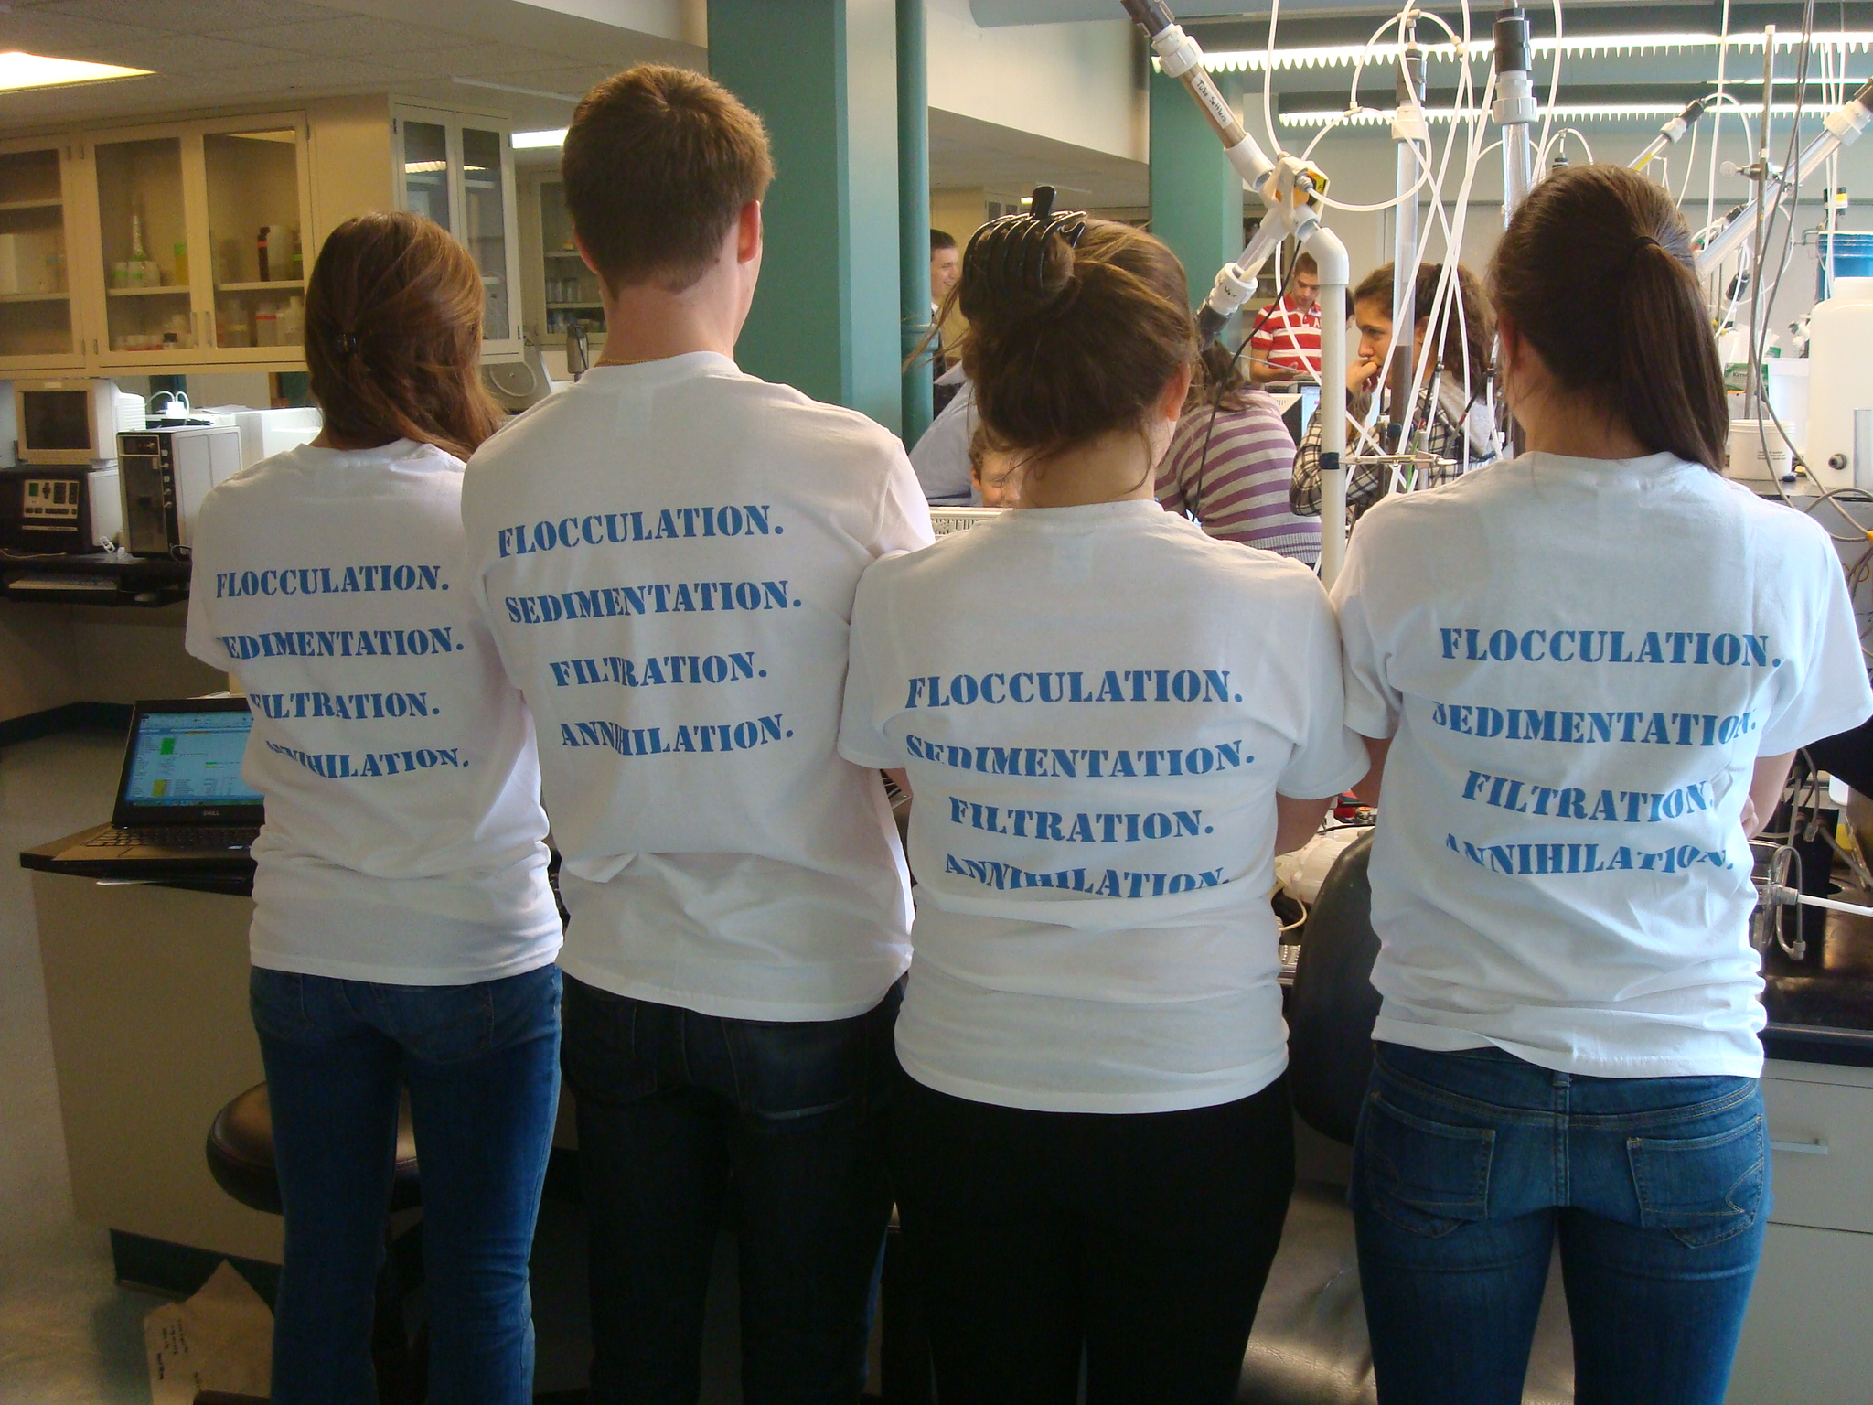
Conventional Surface Water Treatment
Raw water
Screening
Filtration
sludge
sludge
Coagulant
Rapid Mix
Cl₂
Disinfection
Flocculation
Storage
Sedimentation
Distribution
sludge

Slide 7
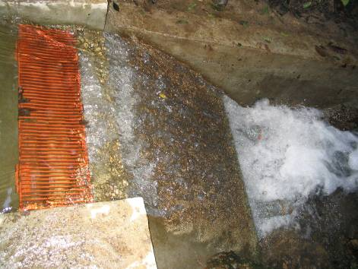
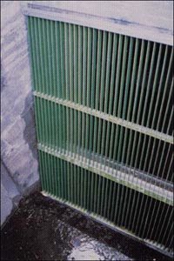
Screening
Removes large solids
  logs
  branches
  rags
  fish
Simple process
  may incorporate a mechanized trash removal system
Protects pumps and pipes in Treatment Plant

Slide 8
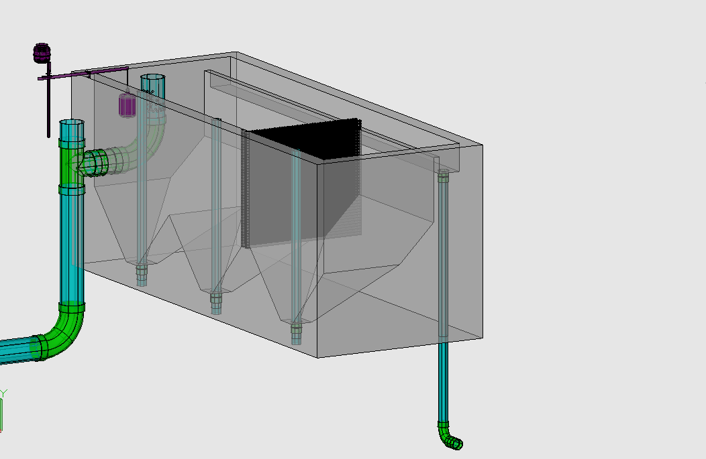
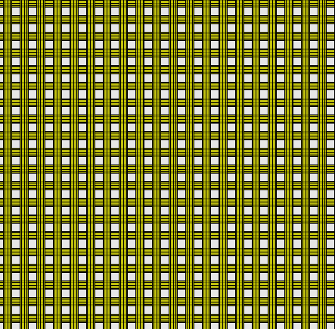
Chemical Dose Controller
Entrance Tank
Overflow Weir
LFOM
Trash Rack
Hopper
Primary Sludge Drain

Slide 9
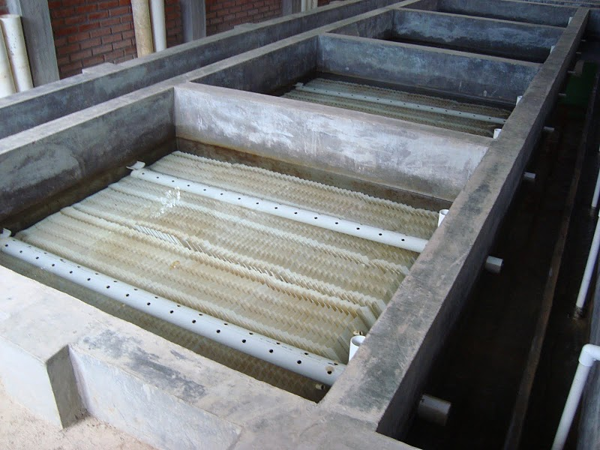
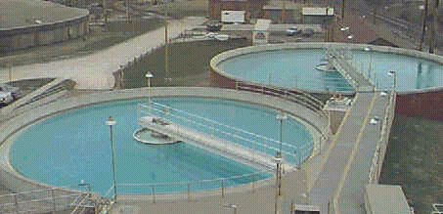
Sedimentation
the oldest form of water treatment
uses gravity to separate particles from water
often follows coagulation and flocculation

Slide 10
Sedimentation: Effect of the particle concentration
Dilute suspensions
  Particles act independently
Concentrated suspensions
  Particle-particle interactions are significant
  Particles may collide and stick together (form flocs)
  Particle flocs may settle more quickly
  Particle-particle forces may prevent further consolidation

Slide 11
How fast do particles fall in dilute suspensions?
What are the important parameters?
  Initial conditions
  After falling for some time...
What are the important forces?
  _________
  __________
Gravity
Fluid drag

Slide 12
Sedimentation:
Particle Terminal Fall Velocity
Identify forces
projected

Slide 13
Sphere Drag
Coefficient
laminar
turbulent
Notes:
13

Slide 14
Example Calculation of Terminal Velocity
Determine the terminal settling velocity of a cryptosporidium oocyst having a diameter of 4 μm and a density of 1.04 g/cm³ in water at 15°C [μ=1.14x10⁻³ kg/(s•m)].
Work in your teams.
Use mks units (meters, kilograms, seconds).
Convert your answer to some reasonable set of units that you understand.
Solution
Reynolds?

Slide 15
Sedimentation Isn’t Enough!
Particles settle too slowly
Would require very large (expensive) sedimentation tanks
Need to make particles settle more quickly
We will figure out how to get particles to settle faster and then we will return to the subject of how to make a sedimentation tank

Slide 16
Sedimentation of Small Particles?
How could we increase the sedimentation rate of small particles?
Increase d (stick particles together)
Increase g (centrifuge)
Increase density difference
(dissolved air flotation)
Decrease viscosity (increase temperature)

Slide 17
Conventional Surface Water Treatment
Raw water
Screening
Filtration
sludge
sludge
Coagulant
Rapid Mix
Cl₂
Disinfection
Flocculation
Storage
Sedimentation
Distribution
sludge

Slide 18
Definitions
Coagulation: The process of adding a sticky solid phase material that attaches to the colloids so they can attach to each other
Flocculation: The process of producing collisions between particles to create flocs (aggregates)

Slide 19

Stages of colloid removal
Coagulation
Flocculation
Floc Blanket
Sedimentation
Filtration
Nanoglob deposition
Collisions
More Collisions
Gravity!
Last chance!
Notes:
Here are the five stages of colloid or particle removal in hydraulic drinking water treatment plants. The first stage, coagulation, involves the addition of a chemical coagulant to destabilize a suspension of particles. The coagulant precipitates and attaches to the particle surface. Then in flocculation, velocity gradients in the water cause the particles (now coated in precipitated coagulant) to collide and stick to one another forming aggregates. In sedimentation, fluid flow is very slow and the aggregates settle to the bottom of the tank. Filtration is often used to remove any remaining particles but is not included in the bench-scale setup.

Slide 20
Aluminum Sulfate Chemistry Alum [Al₂(SO₄)₃*14.3H₂O]
A widely used coagulant
Typically 10 mg/L to 100 mg/L alum is used (0.9 to 9 mg/L as Al)
High concentrations (stock solutions) don’t precipitate because the pH is low
The alum precipitates when it blends with the water in the water treatment plant
The primary reaction produces Al(OH)₃
Al₂(SO₄)₃ + 6H₂O→2Al(OH)₃ + 6H⁺ + 3SO₄⁻²
pH = -log[H⁺]
Notes:
In this sentence “complex” may be a clue that coagulant is not well understood.

Slide 21

Coagulation Geometry
Notes:
Our smallest aggregates were the control, at 180 nm. There were 95 PACl aggregates per clay.

Slide 22
Nanoglob Deposition

Slide 23
Coagulant introduction with rapid mixing
The coagulant must be mixed with the water
In small plants the mixing element could be an elbow or orifice in a pipe
For the WTP design competition mixing will occur in the tubing without any special effort

Slide 24
Chemical Dose Controller
Entrance Tank
Overflow Weir
LFOM
Trash Rack
Hopper
Primary Sludge Drain
Rapid Mix

Slide 25
State of the Art Flocculators
GOAL: convert tiny colloids into large flocs and don’t leave any tiny colloids in the suspension
Two main types
  Mechanical flocculators
  Hydraulic flocculators
Design objective
  Mix to cause collisions
  Mix gently to not cause floc breakup
  Mix long enough so that very few non settleable colloids remain
Notes:
25

Slide 26
Flocculation
Coagulant nanoglob deposition has made the colloids sticky
Now we want to get the particles to collide
We need relative motion between particles
  ________ ________ (effective for particles smaller than 1 μm)
  _________ _____________ (big particles settle fast and fall on smaller particles)
  _______ __________
Brownian motion
Differential sedimentation
Velocity gradients

Slide 27
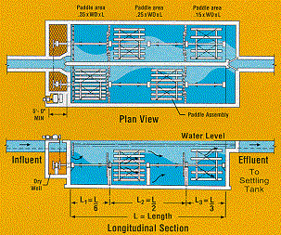
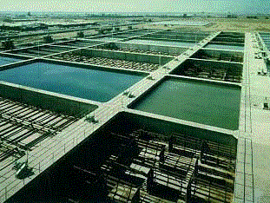
Mechanical Flocculation
Shear provided by turbulence created by gentle stirring
Turbulence also keeps large flocs from settling so they can grow even larger!
Retention time of 10 - 30 minutes
Advantage is that amount of shear can be varied independent of flow rate
Disadvantage is the tanks are far from plug flow

Slide 28
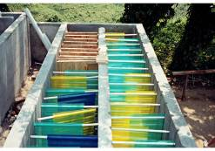
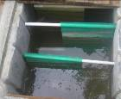
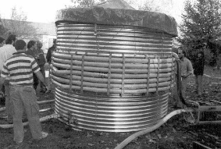
Hydraulic Flocculators
Types
  Horizontal baffle
  Vertical baffle
  Pipe flow
Questions for design
  How long must the suspension be in the “reactor”
  How should the geometry of the reactor be determined?

Slide 29
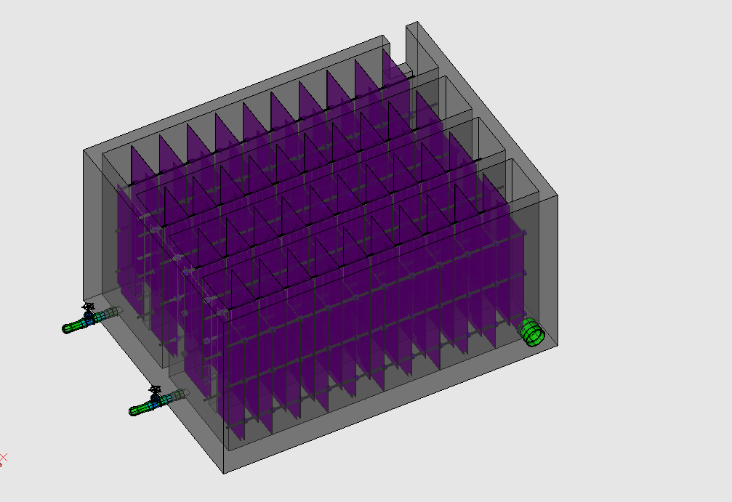
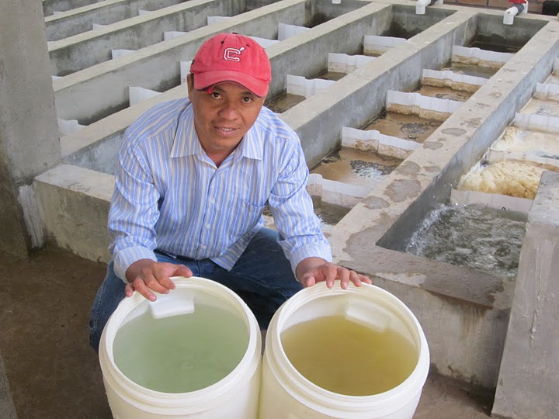
Flocculator
Rapid Mix Pipe

Slide 30
Velocity Gradient Flocculation
With fixed frame of reference
With red particle as frame of reference

Slide 31
Increase Velocity Gradient
Velocity gradient!

Slide 32
Flocculation Reactor Design
Critical design is when floc volume is low
Higher velocity gradients would decrease the characteristic collision time
What do you think φ_{Floc} does as the flocs grow in size?
Dilute suspensions take longer to flocculate!

Slide 33
Shear
Why not design a tiny reactor with huge velocity gradients?
The tangential force experienced by a fluid in a velocity gradient is proportional to the viscosity of the fluid
Fluid viscosity
Velocity gradient
Shear

Slide 34
Laminar Flow Flocculator Design
G should be approximately 50/s
Gθ should be at least 20,000 where θ is the hydraulic residence time in the flocculation reactor
Reactor volume
Flow rate
Notes:
Schulz, C. R. and D. A. Okun (1984). Surface Water Treatment for Communities in Developing Countries, John Wiley & Sons.

Slide 35
Laminar Flow Pipe Flocculation: for tiny flows!
The average value for G is approximately 50/s
These equations assume laminar flow
Laminar flow requires that the Reynolds number be less than 2000
Notes:
(http://www.yale.edu/env/elimelech/publication-pdf/Ching-Tanaka-Elimelech-WaterResearch-1994.pdf)

Slide 36
Given Gθ, Q and d, Find Floc Tube Length
True for laminar flow
Recommended length of flocculator

Slide 37
Laminar Pipe Flow
displacement
r
r
Velocity gradient
velocity

Slide 38
Flocculation Insights
Coagulant nanoglobs also attach to the reactor walls and are “lost”
  This is a VERY significant loss of coagulant in laboratory flocculators
  Consider a deposition chamber
Big flocs are useless at sweeping up little colloids because the shear at the surface of the big flocs is too high for colloids to attach
  Consider breaking flocs!
  The break/reform process may be occurring in hydraulic flocculators

Slide 39
Sedimentation Reactor Design
Raw water
Screening
Filtration
sludge
sludge
Coagulant
Rapid Mix
Cl₂
Disinfection
Flocculation
Storage
Sedimentation
Distribution
sludge

Slide 40

Sedimentation Basin:
Worst Path for Capturing Particle
Horizontal velocity
flow rate
Outlet zone
H
Inlet zone
WH
Sludge zone
Vertical velocity
L
Sludge out
V_{c} = particle velocity that just barely ______________
gets captured
What is V_{c} for this sedimentation tank?

Slide 41
Sedimentation Basin:
Importance of Tank Surface Area
Time in tank
W
H
V_{c} is a property of the sedimentation tank!
L
Want a _____ V_{c}, ______ A_{s}, _______ H, _______ θ.
small
large
small
large
Suppose water were flowing up through a sedimentation tank. What would be the velocity of a particle that is just barely captured?

Slide 42
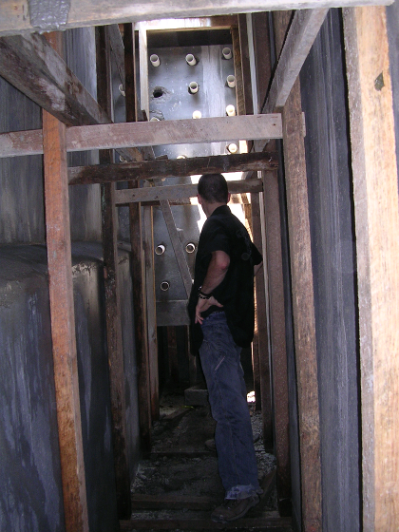
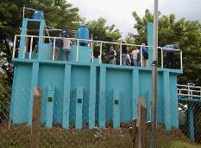
Conventional Sedimentation Basin
long rectangular basins
4-6 hour retention time
3-4 m deep
max of 12 m wide
max of 48 m long
Ratio of surface area to cross sectional area must be less than 18
What is V_{c} for conventional design?
Settling zone
Outlet zone
Inlet zone
Sludge zone
Sludge out
Notes:
Ratio of surface area to cross sectional area must be less than 18. Water Quality and Treatment 5th edition page 7.30

Slide 43
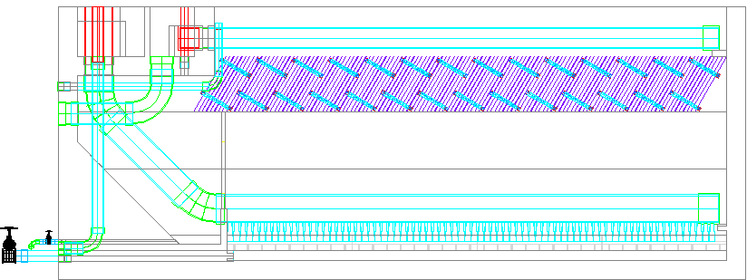
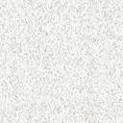
AguaClara Sedimentation Tank:
3 Zones!
Entrance Channel
Exit Channel
Launder
Plate Settlers
Sedimentation
Floc Weir
Floc blanket
Floc Hopper
Inlet Manifold
Diffusers
Consolidation
Floc Hopper Drain (to remove sludge either continuously or every few hours)
Sed Tank Drain (for occasional tank maintenance and inspection or to dump floc blanket)

Slide 44
Defining Capture Velocity for Plate and Tube Settlers
It can be shown that…
L
h
This ratio is the performance gain from using plate settlers
b
α
V_{up}
V_{α}
V_{Up} is the vertical velocity obtained by dividing the flow by the horizontal cross sectional area

Slide 45
Lamella Design Strategy
Angle is approximately 60° to get solids to slide down the incline
Lamella spacing must be large relative to floc size (flocs can be several mm in diameter)
Upflow velocity (Q/A_{s}) can be 1 mm/s

Slide 46
Tube Settler Design
Instead of

Slide 47
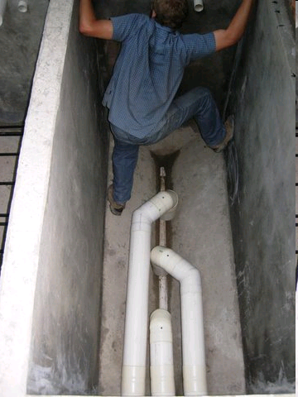
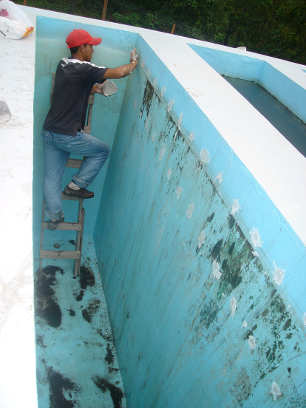
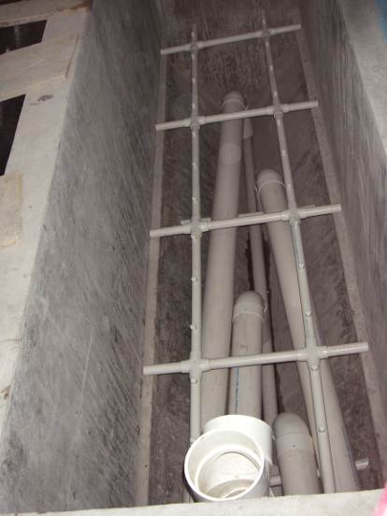
AguaClara Evolution
Ojojona - Vertical Flow Sedimentation (2 m)
Tamara and Marcala - sloped bottoms of the tanks (2 m)
4 Comunidades - Inlet manifold below the sloped bottoms (1.55 m) and no elevated platforms
Agalteca – Inlet manifold pipe with orifices

Slide 48
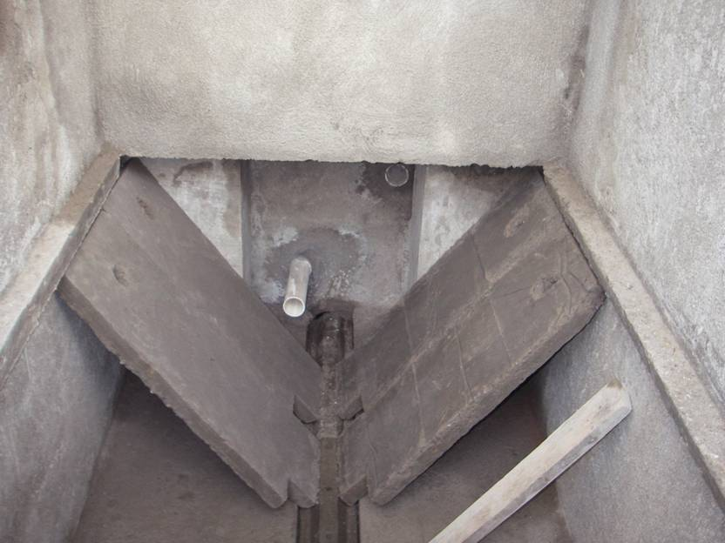
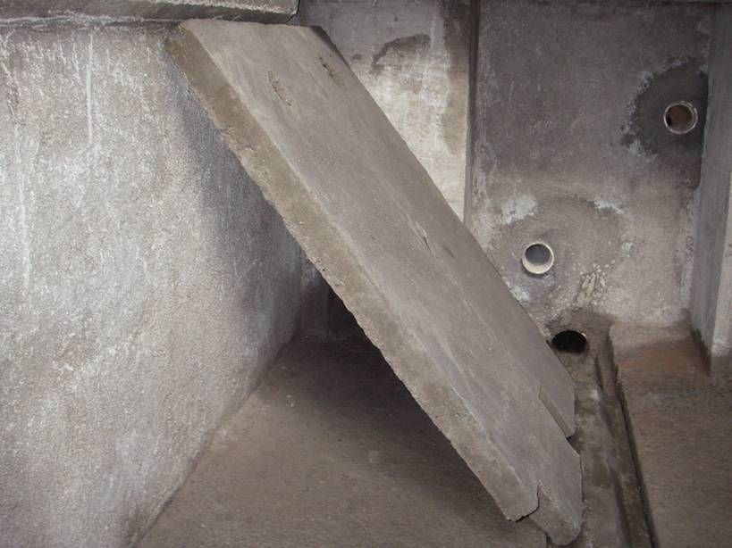
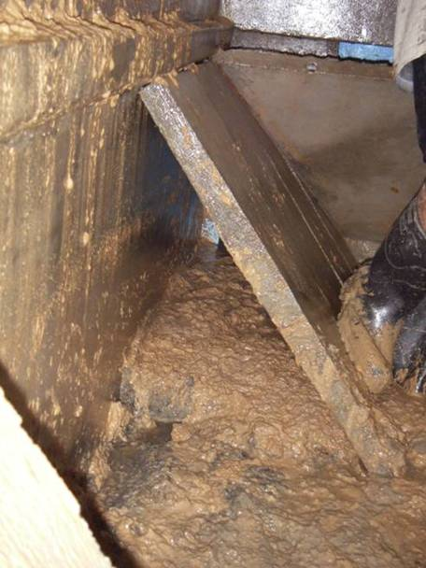
Cuatro Comunidades

Slide 49
Brainstorm
Why is this problem occurring?
How would you fix this problem?
What concepts might be important in obtaining a solution?
What are some of the other constraints that must be considered?

Slide 50
Large scale circulation and poor performance

Slide 51
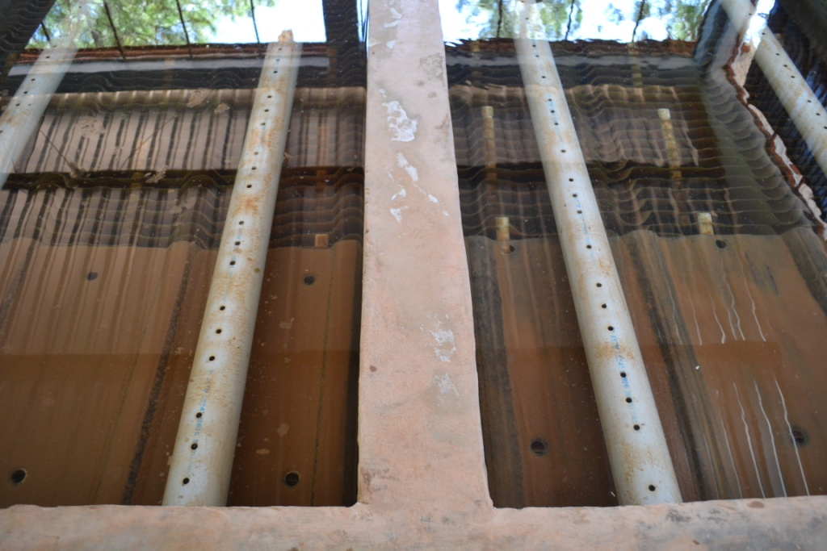
Floc escape at Agalteca (2009)

Slide 52
Flow Straightening Tubes to Eliminate Circulation
Notes:
This was tested at multiple plants and is much better than the manifolds that were simple pipes with a row of holes!

Slide 53
1) No floc blanket and 2) Poor capture of flocs!

Slide 54
Floc Blankets
A high concentration of flocs that form in an upflow sedimentation tank
Floc blankets helps reduce the settled water turbidity and may be a key unit process in helping AguaClara meet our less than 1 NTU goal
Optimal upflow velocity for floc blankets is approximately 1 mm/s
Method to resuspend ALL settled flocs is key to creating a floc blanket

Slide 55
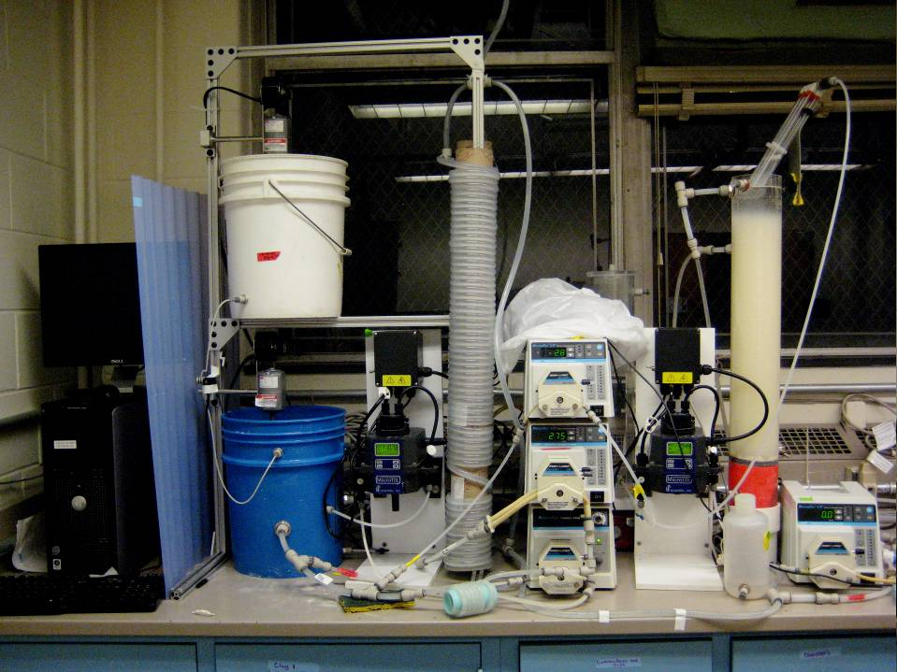

Slide 56
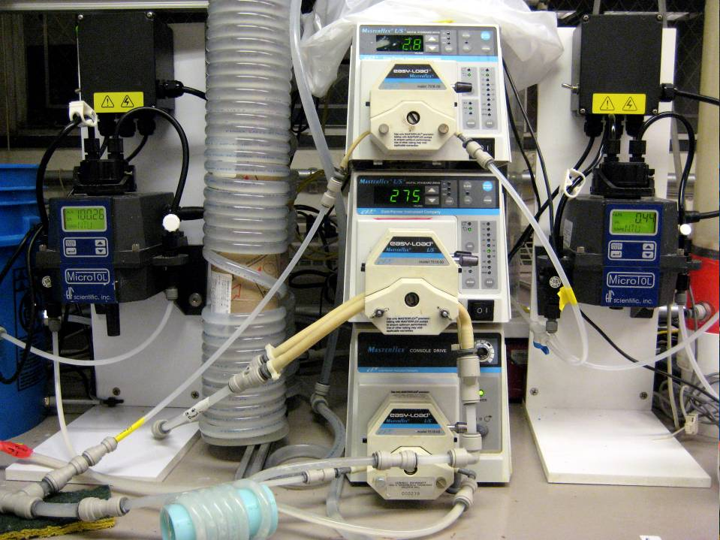

Slide 57
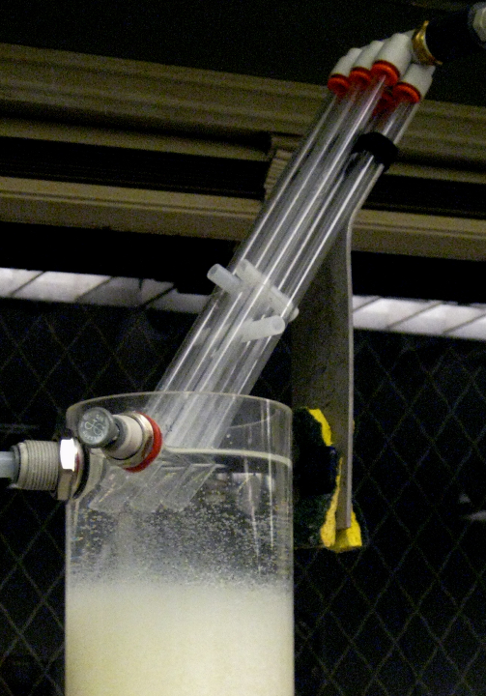
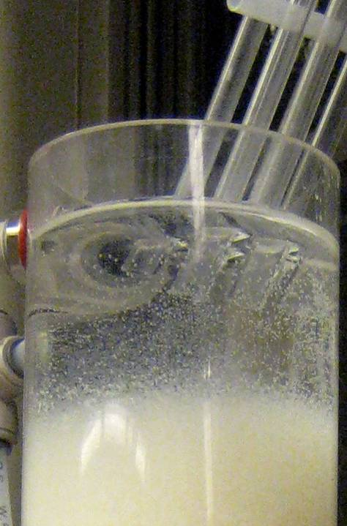

Slide 58
Back to the lab: Geometry matters!

Slide 59
Floc Blanket Resuspender
Diffuser tube flattened to achieve line source
Floc pickup location
Removable drain cover
Jet reverser
Drain orifice
Drain

Slide 60
Floc Blanket formation
Notes:
http://www.youtube.com/watch?v=wa66el51uiY&feature=player_embedded

Slide 61
Mini Sedimentation Tank
What tasks should it excel at performing?
What processes would be helpful?
What equations (or design guidelines) will you use to design it?
What should it look like? (geometry is everything) Draw it!
Defend it – what does it do well
How might it fail? (Learn from AguaClara failures and successes)

Slide 62
Reflections on Sedimentation
What are the three functional zones in an AguaClara sedimentation tank?
What is the size of each of these zones?
All flocs that enter a sedimentation tank must eventually make it to the floc hopper
How many sedimentation tanks should you make for the mini water treatment plant? (How would you decide?)

Slide 63
Conventional Surface Water Treatment
Raw water
Screening
Filtration
sludge
sludge
Coagulant
Rapid Mix
Cl₂
Disinfection
Flocculation
Storage
Sedimentation
Distribution
sludge

Slide 64

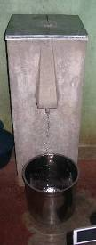




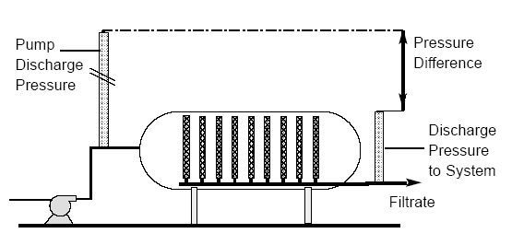

Filters Galore
Slow Sand
Bag
Rapid Sand
Cartridge
Pot
“Bio” Sand
Diatomaceous earth filter
Rough
Candle

Slide 65
Slow Sand Filtration
First filters to be used on a widespread basis
Fine sand with an effective size of 0.2 mm
Low flow rates (0.03 – 0.1 mm/s)
Schmutzdecke (_____ ____) forms on top of the filter
  causes high head loss
  must be removed periodically
Used without coagulation/flocculation!
filter cake

Slide 66
Diatomaceous Earth Filters
Diatomaceous earth (DE) is made of the silica skeletons of diatoms
DE is added to water and then fed to a special microscreen
The DE already on the microscreen strains particles and DE from the water
The continuous DE feed prevents the gradually thickening DE cake from developing excessive head loss
Was seriously considered for Croton Filtration Plant

Slide 67
Membrane Filters
Much like the membrane filters used to enumerate coliforms
  much greater surface area
Produce very high quality water (excellent particle removal)
Clog rapidly if the influent water is not of sufficiently high quality
More expensive than sand and DE filters

Slide 68
Rapid Sand Filter
(Conventional US Treatment)
Size
(mm)
0.70
0.45 - 0.55
5 - 60
Specific
Gravity
1.6
2.65
2.65
Depth
(cm)
30
45
45
Anthracite
Influent
Sand
Gravel
Drain
Effluent
Wash water

Slide 69

Particle Removal Mechanisms in Filters
Transport to a surface
collector
Molecular diffusion
Inertia
Gravity
Interception
Attachment
Straining
Gravity
Sticky aluminum

Slide 70
Filter Design
Filter media
  silica sand and anthracite coal
  non-uniform media will stratify with _______ particles at the top
Flow rates
  2.5 - 10 m/hr (0.7 - 3 mm/s)
Backwash rates
  set to obtain a bed porosity of 0.65 to 0.70
  typically 11-14 mm/s
smaller

Slide 71
Backwash
Wash water is treated water!
WHY?
Anthracite
Only clean water should ever be on bottom of filter!
Sand
Influent
Gravel
Drain
Effluent
Wash water

Slide 72
Ways to Improve Filtration
Filter to waste
Extended Terminal Sub-fluidization Wash
Eliminate surface filtration by injecting influent into sand bed?
Low dose of coagulant feed into filter! (50 - 100 μg/L aluminum)

Slide 73
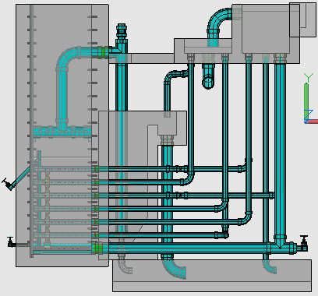
AguaClara Stacked Rapid Sand Filtration
Filtration Entrance Tank (from Sedimentation Tank)
Exit Tank

Slide 74
Disinfection
Disinfection: operations aimed at killing or ____________ pathogenic microorganisms
Ideal disinfectant
  _______________
  _______________
  _______________
  _______________
  _______________
inactivating
Toxic to pathogens
Not toxic to humans
Fast rate of kill
Residual protection
Economical

Slide 75

Disinfection Options
Chlorine
  chlorine gas
  sodium hypochlorite (bleach)
Ozone
Irradiation with Ultraviolet light
Sonification
Electric Current
Gamma-ray irradiation
Poisonous gas – risk of a leak

Slide 76
Chlorine
First large-scale chlorination was in 1908 at the Boonton Reservoir of the Jersey City Water Works in the United States
Widely used in the US
Typical dosage (1-5 mg/L)
  variable, based on the chlorine demand
  goal of 0.2 mg/L residual
Trihalomethanes (EPA primary standard is 0.08 mg/L)
Chlorine oxidizes organic matter
Pathogen/carcinogen tradeoff

Slide 77
Chlorine Reactions
Charges
0
+1
-2
+1
-1
Cl₂ + H₂O → H⁺ + HOCl + Cl⁻
HOCl ↔ H⁺ + OCl⁻
The sum of HOCl and OCl⁻ is called the ____ ______ _______
HOCl is the more effective disinfectant
Therefore chlorine disinfection is more effective at ________ pH
HOCl and OCl⁻ are in equilibrium at pH 7.5
Hypochlorous acid
Hypochlorite ion
free chlorine residual
low

Slide 78
EPA Pathogen Inactivation Requirements
Safe Drinking Water Act
SDWA requires 99.9% inactivation for Giardia and 99.99% inactivation of viruses
Giardia is more difficult to kill with chlorine than viruses and thus Giardia inactivation determines the CT
Concentration x Time
Enumerating Giardia is difficult, time-consuming and costly.
How would you ensure that water treatment plants meet this criteria?
Where are Giardia removed/inactivated?

Slide 79
EPA Credits for Giardia Inactivation
Treatment type Credit
Conventional Filtration 99.7%
Direct Filtration* 99%
Disinfection f(time, conc., pH, Temp.)
* No sedimentation tanks

Slide 80
Disinfection CT Credits
To get credit for 99.9% inactivation of Giardia:
Contact time (min)
chlorine pH 6.5 pH 7.5
(mg/L) 2°C 10°C 2°C 10°C
0.5 300 178 430 254
1 159 94 228 134

Slide 81
Ozone
Widely used in Europe
O₃ is chemically unstable
Must be produced on site
More expensive than chlorine (2 - 3 times)
Typical dosages range from 1 to 5 mg/L
Often followed by chlorination so that the chlorine can provide a protective _______
residual

Slide 82
Removal of Dissolved Substances (1)
Aeration (before filtration)
  oxidizes iron or manganese in groundwater
  oxidized forms are less soluble and thus precipitate out of solution
  removes hydrogen sulfide (H₂S)
Softening (before filtration)
  used to remove Ca⁺² and Mg⁺²
  usually not necessary with surface waters

Slide 83
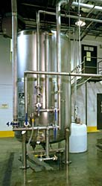
Removal of Dissolved Substances (2)
Activated Carbon (between filtration and disinfection)
  extremely adsorbent
  used to remove organic contaminants
  spent activated carbon can be regenerated with superheated steam
Reverse Osmosis
  semi-permeable membrane allows water molecules to pass, but not the larger ions and molecules
  primarily used for desalination
  also removes organic materials, bacteria, viruses, and protozoa

Slide 84
Summary
Stacked Rapid Sand Filters
Flocculator
Sedimentation
Tanks
Entrance Tank

Slide 85
Cryptosporidium Oocyst

Slide 86
Reynolds Number Check
Re = 1.1 x 10⁻⁶
Re<<1 and therefore in Stokes Law range

Slide 87
Diatomaceous Earth
Clay
DE

Slide 88
Filtration cycle
Inlet box
Outlet box
Where are water levels that show head loss through the sand?
Which water levels change as the sand clogs?
Filter box
Slotted pipes
Sand bed
Notes:
Mickey Adelman, 2011

Slide 89
Backwash cycle
Air valve
Siphon
Where are water levels that show head loss during backwash?
What water are we using to backwash this filter?
Backwash box
Notes:
Mickey Adelman, 2011

Slide 90

Begin Filtration

Slide 91
Begin Backwash
Notes:
Need to analyze the beginning of the siphon right after the air pressure is equalized with atmospheric pressure. It appears that we may need the height of water above the top of the siphon tube to equal the depth of submergence of the end of the siphon to initiate flow through the siphon

Slide 92
End Backwash

Slide 93
Backwash of Stacked Rapid Sand Filter – Pilot Scale
Notes:
http://youtu.be/k7rSmWs4gZI

Slide 94
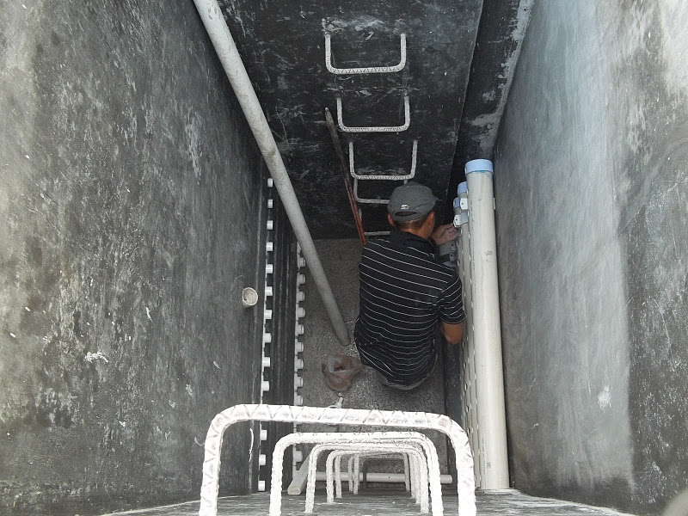

Slide 95
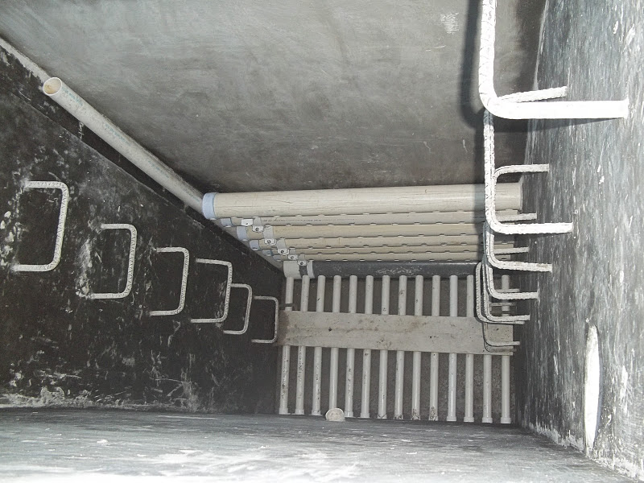

Slide 96
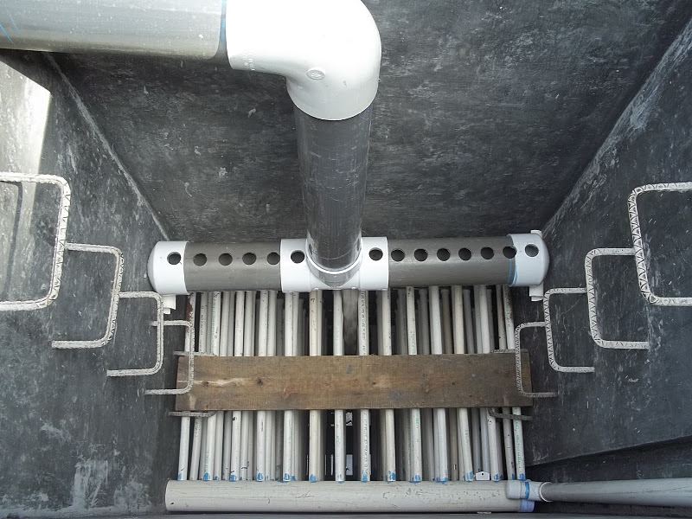

Slide 97
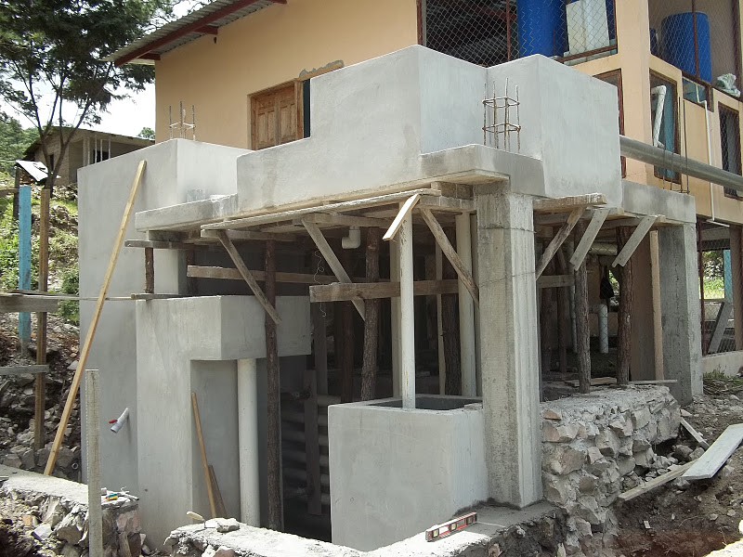

Slide 98
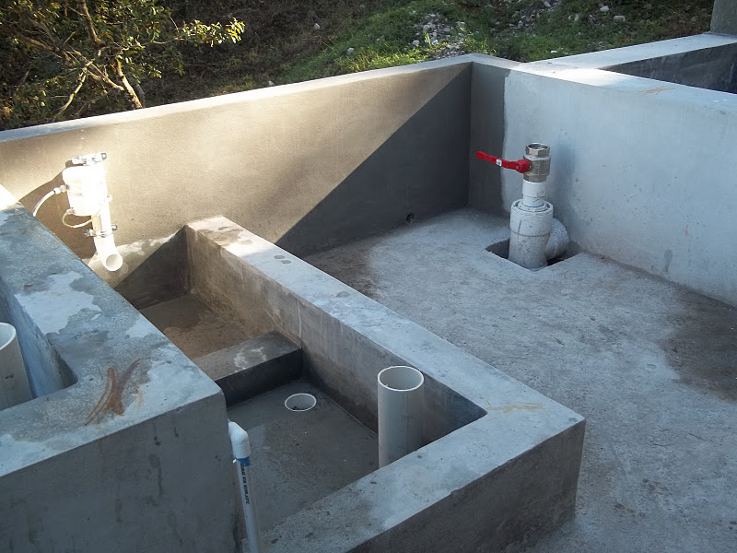

Slide 99
